Slide 1

Auction strategy for new IPL franchise by analyzing past IPL data to create a strong and balanced squad
By Rohan Bhandari D (1st August Data Science Batch )

Slide 2
1.Aggressive Batsmen with High strike rates .
select batsman,
count(batsman) as No_of_Balls_Faced,
sum(batsman_runs) as Total_runs,
round(((sum(batsman_runs)*1.0)/count(batsman))*100,2) as
Strike_rate
from IPL_Ball group by batsman
having count(batsman)>500
order by Strike_rate desc
limit 10;

Slide 3
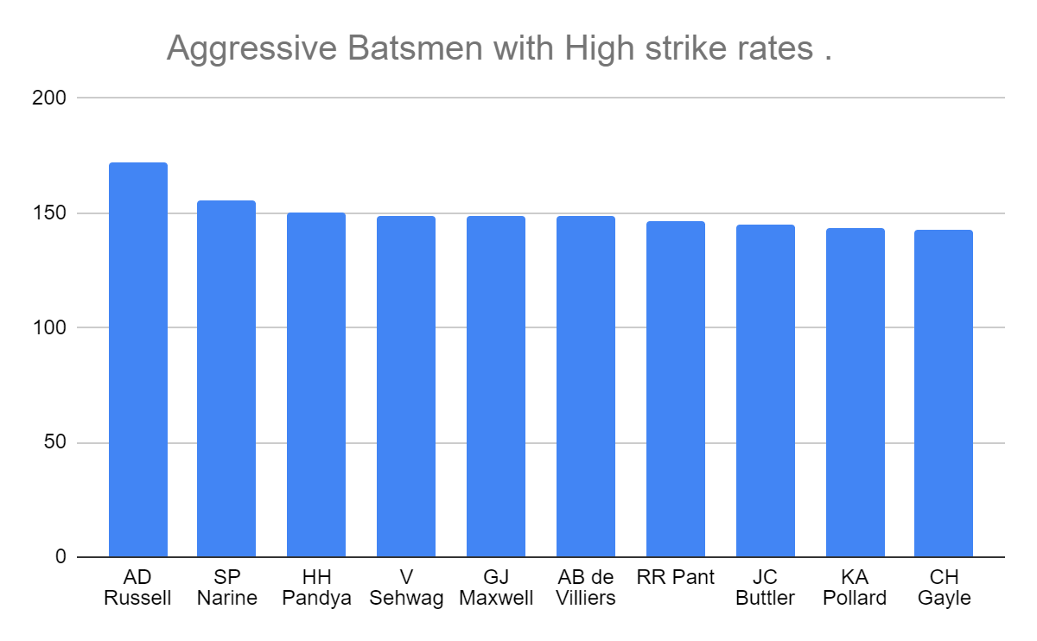
( For Table data is linked with the chart )
And top 3 selected as first choice

Slide 4
2.Batsmen with best Batting Average
SELECT a.batsman, a.Total_Runs, b.match AS Total_NumberOfTimes_out, round(((a.Total_Runs*1.0)/b.match),2) AS Average, c.seasons AS "No.Seasons Played"
FROM (SELECT batsman, SUM(batsman_runs) AS Total_Runs FROM ipl_ball GROUP BY batsman) as a
INNER JOIN(SELECT DISTINCT player_dismissed, COUNT(DISTINCT id) AS match
FROM ipl_ball
WHERE player_dismissed != 'NA'
GROUP BY player_dismissed) AS b
ON a.batsman=b.player_dismissed
INNER JOIN (SELECT iplb.batsman, COUNT(DISTINCT DATE_PART('year', iplm.date)) AS Seasons
FROM ipl_ball AS iplb
JOIN ipl_matches AS iplm
ON iplb.id=iplm.id
GROUP BY batsman) AS c
ON a.batsman=c.batsman
WHERE c.seasons>2 AND a.Total_Runs>500
ORDER BY Average DESC
LIMIT 10;

Slide 5
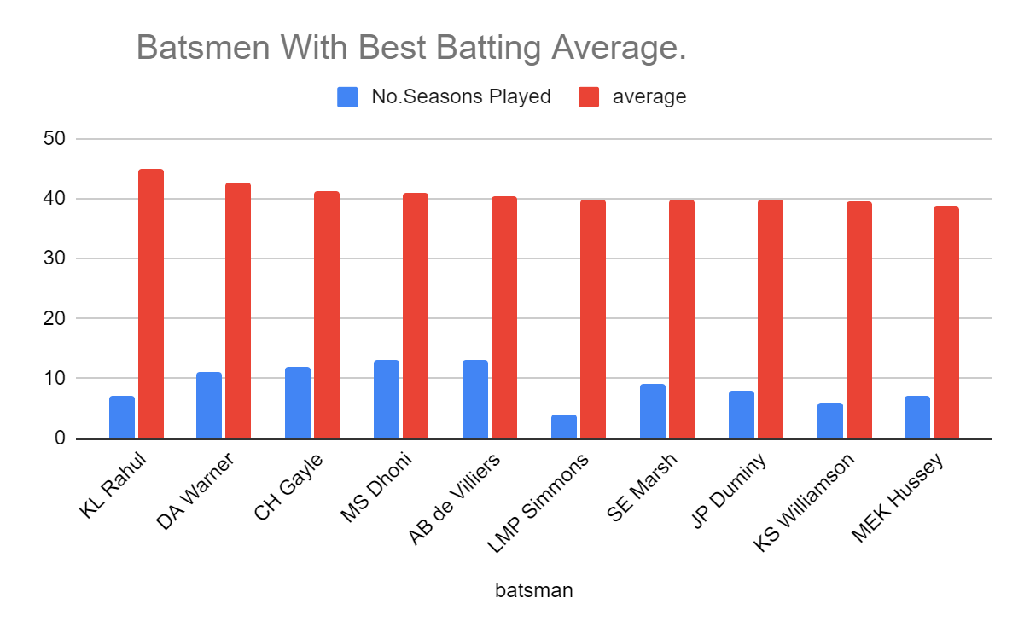

Slide 6
3.Batsmen with Most Boundaries.
SELECT DISTINCT iplb.batsman, s.seasonAS Numberof_seasons_played, m.matchAS Numberof_matchs, b.ovar_boundaries AS Numberof_sixes, ROUND((b.ovar_boundaries*1.0/m.match),2) as "sixes_per_match", a.boundaries AS Numberof_fours, ROUND((a.boundaries*1.0/m.match),2) as four_per_match,
Round((ROUND((b.ovar_boundaries*1.0/m.match),2)+ROUND((a.boundaries*1.0/m.match),2))/2,2) AS avg_boundary
FROM ipl_ball AS iplb
JOIN (SELECT batsman, COUNT(batsman_runs) AS boundaries FROM ipl_ball WHERE batsman_runs=4 GROUP BY batsman ) AS a
ON iplb.batsman=a.batsman
JOIN (SELECT batsman, COUNT(batsman_runs) AS ovar_boundaries FROM ipl_ball WHERE batsman_runs=6 GROUP BY batsman ) AS b
ON iplb.batsman=b.batsman
JOIN (SELECT iplb.batsman, COUNT(DISTINCT DATE_PART('year', im.date)) AS Season FROM ipl_ball AS iplb JOIN ipl_matches AS imON iplb.id=im.id GROUP BY batsman) AS s
ON iplb.batsman=s.batsman
JOIN(SELECT DISTINCT batsman, COUNT(distinct id) AS match FROM ipl_ball GROUP BY batsman ORDER BY match DESC) AS m
ON iplb.batsman=m.batsman
WHERE s.season>2
ORDER BY avg_boundary DESC LIMIT 10;

Slide 7
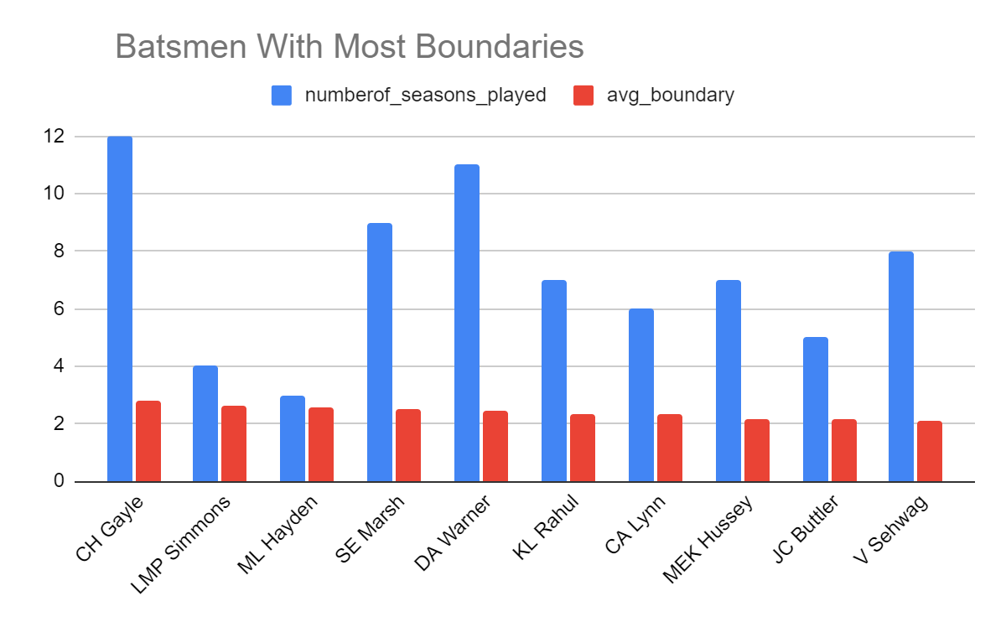

Slide 8
4.Bowlers with best Economy
SELECT bowler,
(COUNT(bowler)/6)||'.'||(COUNT(bowler)%6) asNumberOf_overs_bowled,
COUNT(bowler) AS NumberOf_balls_bowled, SUM(Total_runs) AS Runs_conceded, ROUND(SUM(Total_runs)*1.0/(COUNT(bowler)/6.0),2) AS Economy_Rate
FROM IPL_Ball
GROUP BY bowler HAVING COUNT(bowler)>500
ORDER BY Economy_Rate ASC
LIMIT 10;

Slide 9
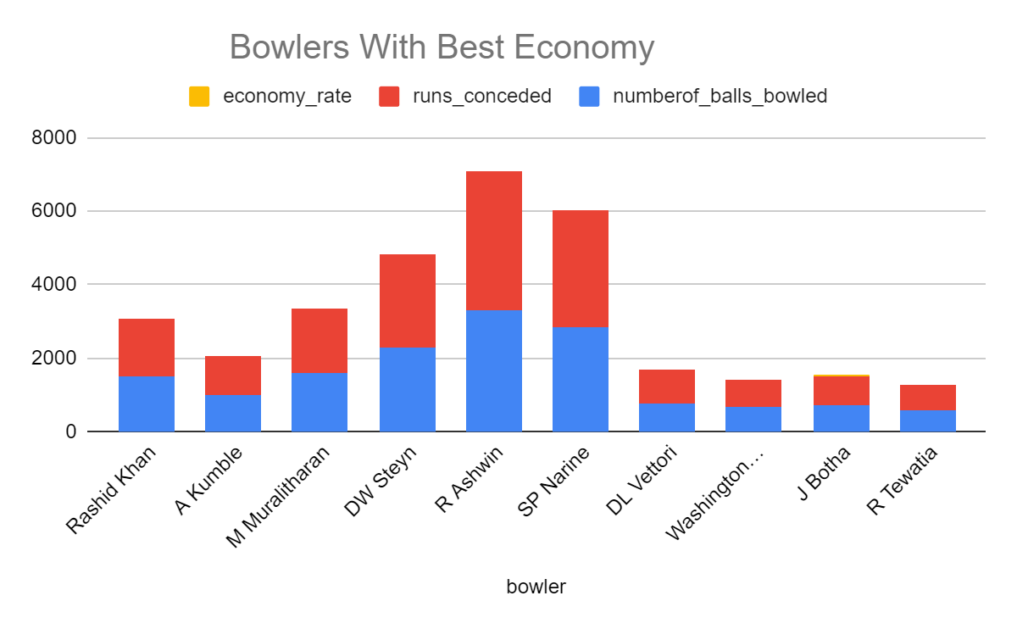

Slide 10
5.Bowlers with best bowling strike rate .
SELECT a.bowler, COUNT(a.bowler) AS NumberOf_balls_bowled, (COUNT(a.bowler)/6)||'.'||(COUNT(a.bowler)%6) as NumberOf_overs_bowled, b.NumberOf_wickets, ROUND(COUNT(a.bowler)*1.0/b.NumberOf_wickets,2) AS Strike_rate
FROM IPL_ball as a
JOIN (SELECT bowler, COUNT(bowler) AS NumberOf_wickets
FROM IPL_ball
WHERE is_wicket=1 AND dismissal_kind !='run out'
GROUP BY bowler) as b
ON a.bowler=b.bowler
GROUP BY a.bowler,b.NumberOf_wickets
HAVING COUNT(a.bowler)>500
ORDER BY Strike_rate
LIMIT 10;

Slide 11
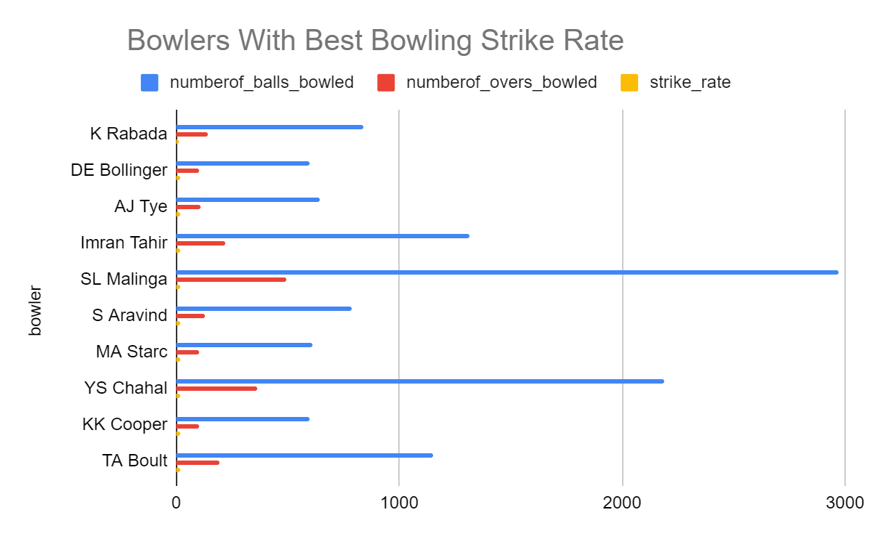

Slide 12
6.All Rounders with best batting and bowling strike rate.
SELECT * FROM (SELECT bl.bowler AS All_rounders, bl.NumberOf_balls_bowled, bl.strike_rate AS bowling_strike_rate, bt.No_Of_Balls_Faced,bt.Total_runs, bt.strike_rate AS batting_strike_rate, ROW_NUMBER() OVER(ORDER BY bt.strike_rate DESC) AS batting_rank, ROW_NUMBER() OVER(ORDER BY bl.strike_rate ASC) AS bowling_rank, ROUND(1.0*(ROW_NUMBER() OVER(ORDER BY bt.strike_rate DESC) + ROW_NUMBER() OVER(ORDER BY bl.strike_rate ASC))/2,2) AS avg_rank FROM (SELECT a.bowler, COUNT(a.bowler) AS NumberOf_balls_bowled, (COUNT(a.bowler)/6)||'.'||(COUNT(a.bowler)%6) as NumberOf_overs_bowled, b.NumberOf_wickets, ROUND(COUNT(a.bowler)*1.0/b.NumberOf_wickets,2) AS Strike_rate FROM IPL_ball AS a
JOIN (SELECT bowler, COUNT(bowler) AS NumberOf_wickets FROM IPL_ball WHERE is_wicket=1 AND dismissal_kind !='run out' GROUP BY bowler) as b
ON a.bowler=b.bowler
GROUP BY a.bowler,b.NumberOf_wickets HAVING COUNT(a.bowler)>500 ORDER BY Strike_rate ) AS bl
JOIN(SELECT batsman,strike_rate,No_Of_Balls_Faced,Total_runs FROM (SELECT batsman,COUNT(batsman) AS No_Of_Balls_Faced, SUM(batsman_runs) AS Total_runs, round(((SUM(batsman_runs)*1.0)/COUNT(batsman))*100,2) AS Strike_rate from IPL_ball group by batsman
HAVING COUNT(batsman)>500
ORDER BY Strike_rate DESC) AS m WHERE No_Of_Balls_Faced>500) AS bt
ON bt.batsman=bl.bowler WHERE bl.NumberOf_balls_bowled>300) AS a ORDER BY avg_rank
LIMIT 10;

Slide 13
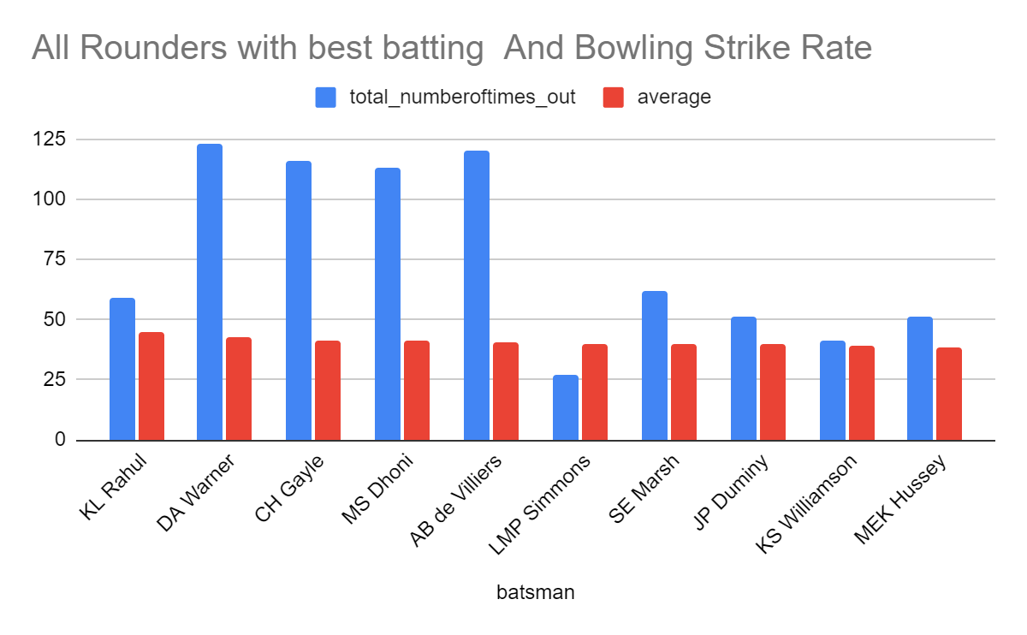

Slide 14
7.Best wicket Keepers
SELECT s.fielder AS Wicket_Keeper, tr.Batting_average, COUNT(s.fielder) AS stumped_count, c.caught_count FROM ipl_ball AS s
LEFT JOIN(SELECT fielder, COUNT(fielder) AS caught_count FROM ipl_ball WHERE dismissal_kind='caught' GROUP BY fielder) AS c ON s.fielder=c.fielder
JOIN (SELECT a.batsman, a.Total_Runs, b.matchAS Total_NumberOfTimes_out, round(((a.Total_Runs*1.0)/b.match),2) AS Batting_Average, c.seasonsAS "No.Seasons Played"
FROM (SELECT batsman, SUM(batsman_runs) AS Total_Runs FROM ipl_ball GROUP BY batsman) as a
INNER JOIN(SELECT DISTINCT player_dismissed, COUNT(DISTINCT id) AS match
FROM ipl_ball WHERE player_dismissed != 'NA' GROUP BY player_dismissed) AS b
ON a.batsman=b.player_dismissed
INNER JOIN (SELECT iplb.batsman, COUNT(DISTINCT DATE_PART('year', iplm.date)) AS Seasons FROM ipl_ball AS iplb JOIN ipl_matches AS iplm ON iplb.id=iplm.id GROUP BY batsman) AS c
ON a.batsman=c.batsmanWHERE c.seasons>2 AND a.Total_Runs>500
ORDER BY Batting_AverageDESC)AS tr ON s.fielder=tr.batsman
JOIN(SELECT DISTINCT batsman, COUNT(distinct id) AS match FROM ipl_ball GROUP BY batsman
ORDER BY match DESC) as m ON s.fielder=m.batsmanWHERE dismissal_kind='stumped'
GROUP BY s.fielder,c.caught_count,tr.Total_runs,tr.Batting_averageORDER BY tr.Batting_average DESC,stumped_count DESC
LIMIT 10;

Slide 15
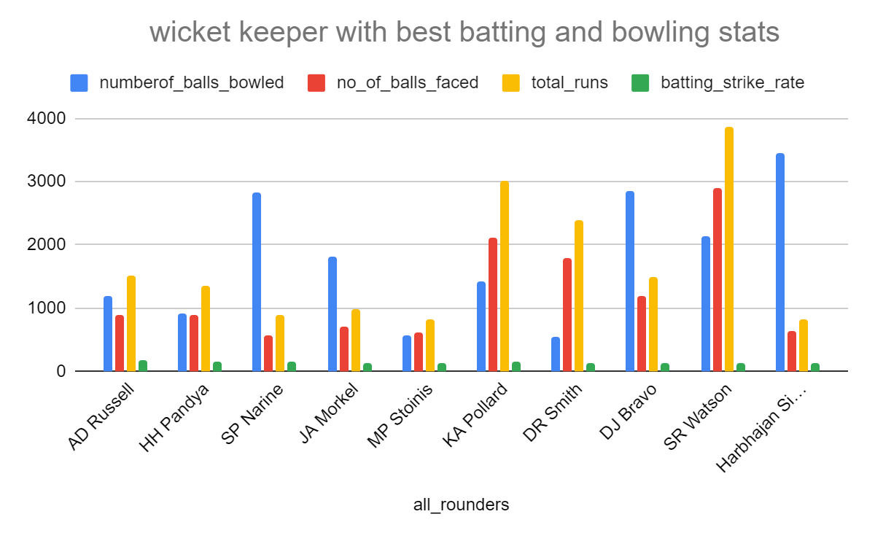

Slide 16
Additional Questions for Final Assessment

Slide 17
1. Get the count of cities that have hosted an IPL match
SELECT DISTINCT city FROM ipl_matches;

Slide 18
2. Create table deliveries_v02 with all the columns of the table ‘deliveries’ and an additional column ball_result containing values boundary, dot or other depending on the total_run (boundary for >= 4, dot for 0 and other for any other number)
CREATE TABLE deliveries_v02 AS
(SELECT *,CASE WHEN total_runs>=4 THEN 'boundary' WHEN total_runs =0 THEN 'dot' WHEN total_runs =2 THEN 'double' WHEN total_runs =1 THEN 'single’ ELSE 'others’ END AS ball_result
FROM ipl_ball);

Slide 19
3. Write a query to fetch the total number of boundaries and dot balls from the deliveries_v02 table.
SELECT DISTINCT ball_result,
COUNT(ball_result) AS boundaries_and_dotballs
FROM deliveries_v02
WHERE ball_result='boundary' OR ball_result='dot'
GROUP BY ball_result;

Slide 20
4. Write a query to fetch the total number of boundaries scored by each team from the deliveries_v02 table and order it in descending order of the number of boundaries scored.
SELECT DISTINCT batting_team,
COUNT(ball_result) AS boundary
FROM deliveries_v02 WHERE ball_result='boundary'
GROUP BY batting_team
ORDER BY boundary DESC;

Slide 21
5. Write a query to fetch the total number of dot balls bowled by each team and order it in descending order of the total number of dot balls bowled.
SELECT DISTINCT bowling_team,
COUNT(ball_result) AS dot_balls
FROM deliveries_v02
WHERE ball_result='dot'
GROUP BY bowling_team
ORDER BY dot_balls DESC;

Slide 22
6. Write a query to fetch the total number of dismissals by dismissal kinds where dismissal kind is not NA
SELECT dismissal_kind,
COUNT(dismissal_kind) AS total_dismissals
FROM deliveries_v02
WHERE dismissal_kind != 'NA'
GROUP BY dismissal_kind;

Slide 23
7. Write a query to get the top 5 bowlers who conceded maximum extra runs from the deliveries table
SELECT DISTINCT bowler,
SUM(extra_runs) AS total_extra_runs
FROM deliveries_v02
GROUP BY bowler
ORDER BY total_extra_runs DESC
LIMIT 5;

Slide 24
8. Write a query to create a table named deliveries_v03 with all the columns of
deliveries_v02 table and two additional column (named venue and match_date) of venue
and date from table matches
CREATE TABLE deliveries_v03 AS (SELECT a.*,b.venue,b.date
FROM deliveries_v02 AS a
LEFT JOIN (SELECT id,venue,date
FROM ipl_matches) as b
ON a.id=b.id);

Slide 25
9. Write a query to fetch the total runs scored for each venue and order it in the descending order of total runs scored.
SELECT DISTINCT venue,
SUM(total_runs) as Total_venue_runs
FROM deliveries_v03
GROUP BY venue
ORDER BY Total_venue_runs DESC;

Slide 26
10. Write a query to fetch the year-wise total runs scored at Eden Gardens and order it in the descending order of total runs scored.
SELECT DISTINCT EXTRACT(year FROM date) AS year,
SUM(total_runs) as Total_venue_runs
FROM deliveries_v03
WHERE venue = 'Eden Gardens'
GROUP BY DISTINCT EXTRACT(year FROM date)
ORDER BY Total_venue_runs DESC;

Slide 27
THANK YOU!!!

